Slide 1

Ecommerce Product Categorization
Komal Sahu

Slide 2
Overview
Effective product categorization is vital for enhancing eCommerce operations. It ensures customers experience seamless navigation to find desired products easily. This presentation focuses on addressing challenges in product categorization using data science techniques and innovative solutions, particularly for ambiguous product descriptions and diverse product offerings.

Slide 3
Approaches for E-commerce Product Categorization :
1. Import necessary Libraries and Load the dataset.
2. Analyze the Dataset to identify key features and missing values .
3. Perform EDA to extract valuable insights from the dataset.
3. Visualize the Data to uncover data patterns and correlations, considering the text-based nature of the dataset.
4. Clean and transform the dataset by handling missing values and inconsistencies.
5. Convert raw product data (text descriptions, specifications) into informative features using techniques like TF-IDF or word embeddings.

Slide 4
Approaches for E-commerce Product Categorization :
6. Detect and address class imbalance in the product category feature.
7. Design and train predictive models using train-test split for both machine learning and deep learning model.
8. Measure model performance using evaluation metrics like accuracy, F1 score, precision, and recall.
9. Optimize model performance by tuning hyperparameters and selecting the most relevant features, if necessary.
10. Evaluate the different model on the test dataset to validate its performance.

Slide 5
Key-Insights :
The Online platform’s highest selling product category is Clothing followed by Jwellery.
The Online platform has moderate sales in Categories such as Footwear, Automotive, Mobiles & Accessories, Home decors & Festive needs, Kitchen & dinning, Computers.
The Online platform has least sales in Bags, Wallets & Belts followed by Baby care, Pens & Stationary, Toys & School Supplies, Tools & Hardware, Watches.

Slide 6
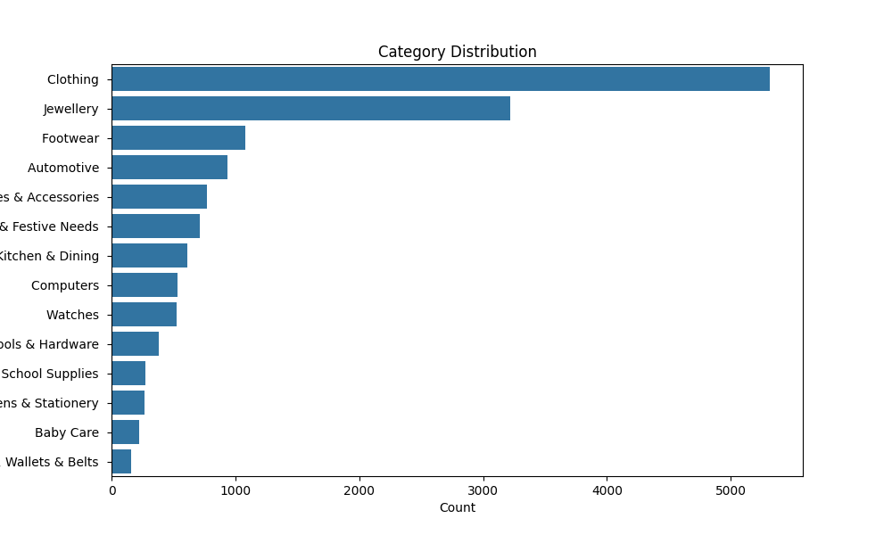
Dataset contains more categories of “Clothing” followed by "Jewellery" and "Footwear" this implies that customers are more interested in buying this products.

Slide 7
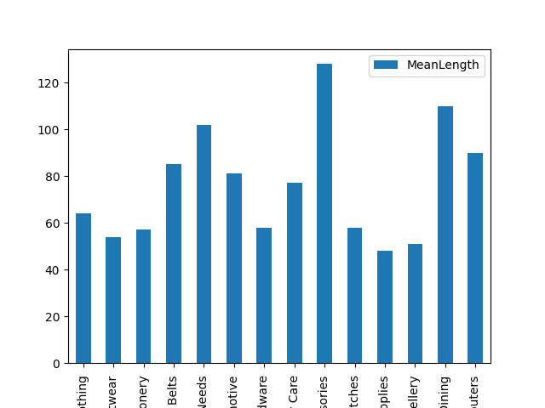
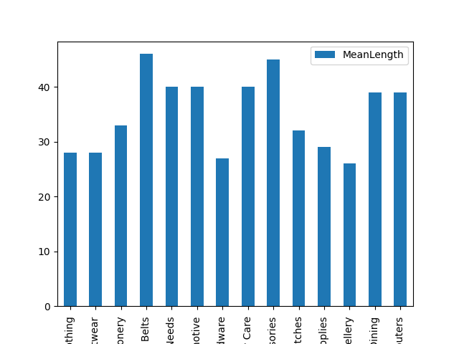
The mean description lenghts for most categories are in the range of :
Before Resampled : Range between 40-120
After resampled : range between 30-40

Slide 8
Business-Insights :
The Business insights of Ecommerce Product Categorization model is provides valuable insights into customer behaviour or different features. Especially in e-commerce or large retail environments we use multi-class text classification to finding the valuable insights for business .
Some of the Business insights for various aspects, are :

Slide 9
1. Scalability for Growth
Explanation: As product catalogs grow, manual categorization becomes infeasible. Scalable methods like machine learning can handle large and diverse inventories effectively.
Example: An e-commerce platform expanding into new categories like electronics or groceries can quickly adapt without overhauling the system.
Impact: Supports business growth without requiring proportional increases in workforce or resources.

Slide 10
2. Increased Sales and Conversions
Explanation: Proper categorization ensures products are easily discoverable, whether through search, filters, or recommendations. This ease of access directly impacts purchasing decisions.
Example: Showing relevant accessories (e.g., socks or water bottles) in the same category as running shoes encourages cross-se
Impact: Higher product discoverability translates to more purchases and better average order values (AOV).

Slide 11
3. Improved User Experience
Explanation: When products are accurately categorized, customers can easily find what they’re looking for through intuitive navigation and search functionality.
Example: A customer searching for “men’s running shoes” is more likely to remain on a platform that accurately narrows down relevant options rather than showing a mix of unrelated items.
Impact: Enhanced user satisfaction leads to increased time spent on the platform, reducing bounce rates.

Slide 12
4. Operational Efficiency
Explanation: Automation in product categorization reduces the need for manual effort, speeding up the process and minimizing errors.
Example: A rule-based or machine learning system can automatically assign categories to thousands of new products daily, saving time for staff.
Impact: Reduced operational costs and faster time-to-market for new products.

Slide 13
5. Personalized Shopping
Explanation: Analyzing user behavior and preferences enables dynamic and personalized categorization, helping customers discover products they’re more likely to buy.
Example: A user frequently browsing fitness apparel might see tailored categories like “Trending in Fitness Gear” or “Recommended for You.”
Impact: Drives customer loyalty and repeat purchases by creating a personalized shopping experience.

Slide 14
6. Competitive Advantage
Explanation: Advanced categorization systems set the platform apart by offering more accurate search results, better recommendations, and a smoother browsing experience compared to competitors.
Example: Competitors with outdated or inaccurate categorization frustrate users, leading them to switch platforms.
Impact: Superior categorization becomes a selling point, attracting new users and retaining existing ones.

Slide 15
7. Cost Optimization
Explanation: Investing in automated categorization reduces long-term costs associated with manual intervention, frequent updates, and error rectification.
Example: A one-time implementation of a machine learning-based system offsets recurring expenses of a team performing manual categorization.
Impact: Significant cost savings over time while maintaining accuracy and efficiency.

Slide 16
8. Data-Driven Insights
Explanation: Categorization systems generate valuable data about customer preferences, product trends, and demand patterns, which can be leveraged for strategic decision-making.
Example: Frequent searches for “eco-friendly products” in specific categories might prompt the business to expand its sustainable product line.
Impact: Enables informed decisions regarding inventory, marketing, and product development, aligning with market demands.

Slide 17
Conclusion
Implementing an effective product categorization strategy has far-reaching business benefits, from improving user experience to driving growth and cost efficiency. It not only enhances current operations but also positions the platform for long-term success in a competitive market.

Slide 18
THANK YOU

